Slide 1
Alternative Analysis
The Art and Science of Guessing…

Slide 2
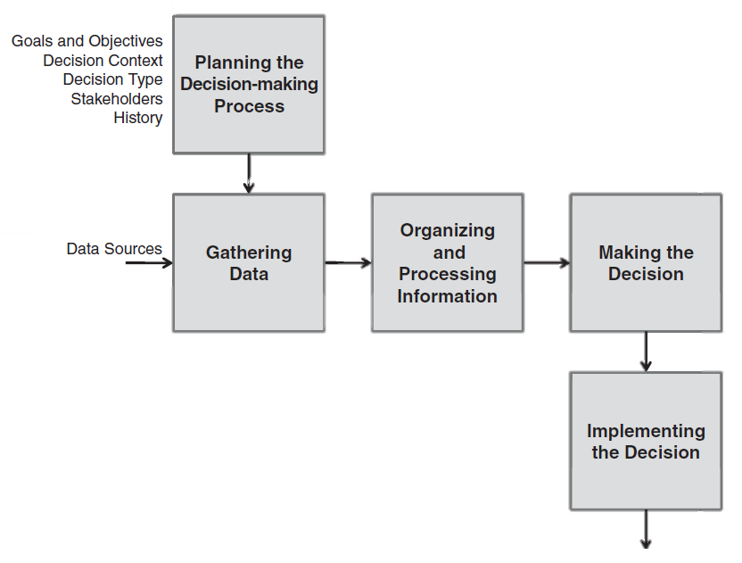

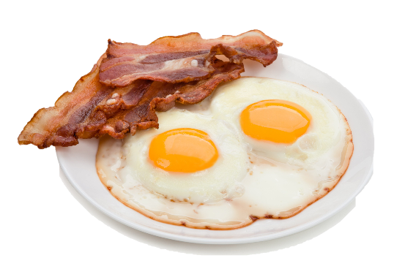

Why evaluate alternatives
Inherent in any process
  What to have for breakfast
Why a formal process?
  Remove subjectivity
  Document decisions

Slide 3
Lesson overview
The formal process of decision making
Aspects to consider and their importance
A method for making decisions
Typical example
Wrap-up

Slide 4
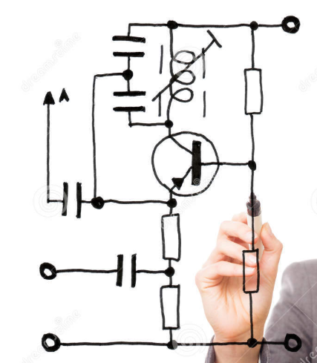

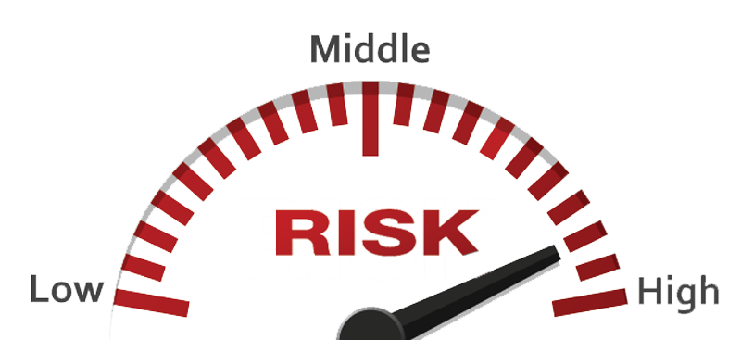
Systems Engineering
Body-of-Knowledge (SEBOK)
Alternatives must be compared across
  Technical parameters
  Financial aspects
  Risk

Slide 5
MOEs and MOPs
Measures of Effectiveness (MOEs)
Measures of Performance (MOPs)
Degree to which system achieves objective
Simple to state
Qualifiable (sometimes Measurable)
Reliability, Manufacturability, Maintainability
Technical parameters
Quantifiable (always measurable)
Range, speed, weight, size, resolution
Parameters used to “keep score”

Slide 6
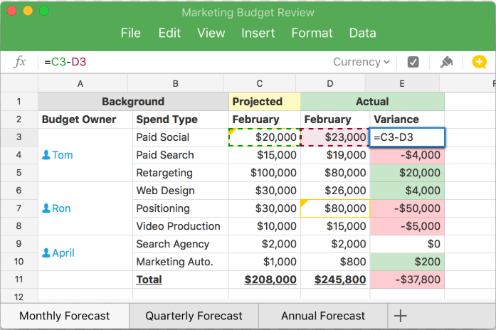
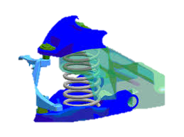
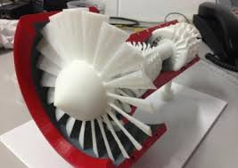
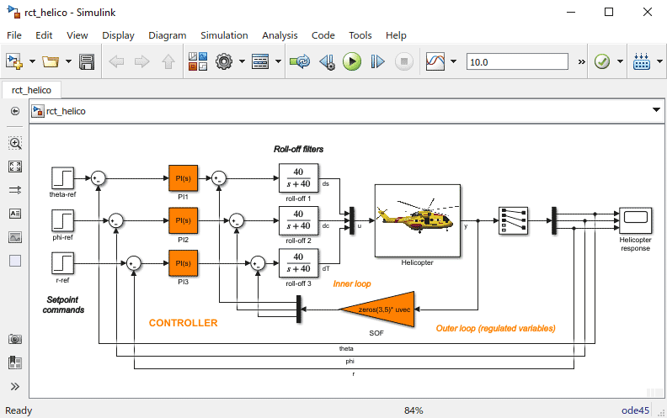
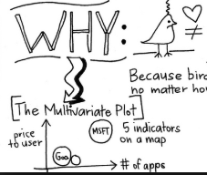
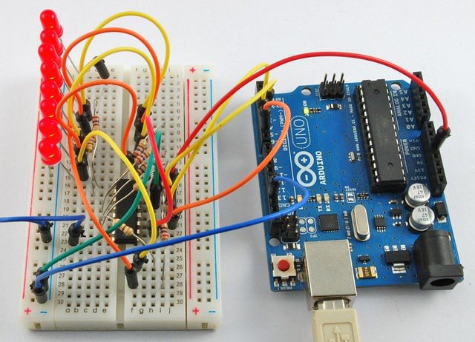
Technical analysis
Heavily dependent on models
  Static models – Flow diagrams
  Mathematical models – Spreadsheets and “back of the napkin”
  Engineering models – Simulation of circuits / physics
  Physical models – Experiments, prototypes, etc.
Spreadsheet
Chiefly concerned with the system / sub-system / component’s PERFORMANCE
Engineering Simulation
Physical prototypes
Back of the Napkin
Notes:
Since physical models are the most expensive we typical try and minimise the use thereof. In some cases their use cannot be avoided, and additional insight is gained. Before selecting a physical prototype determine if there is not a more suitable means of achieving the same goal.
The objective of technical analysis is to determine how well the system / sub-system / component needs to perform a function. In a sense technical analysis is very similar to requirements analysis….

Slide 7

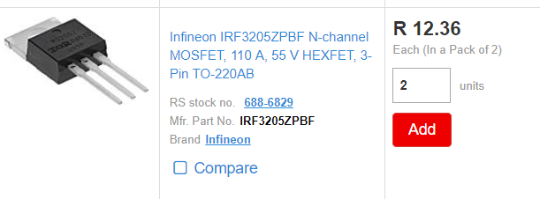
Financial aspects
Not just “part cost”
Life-cycle costing needs to be kept in mind
Uncertainties
  Inflation
  Exchange rates
  Delivery costs

Slide 8
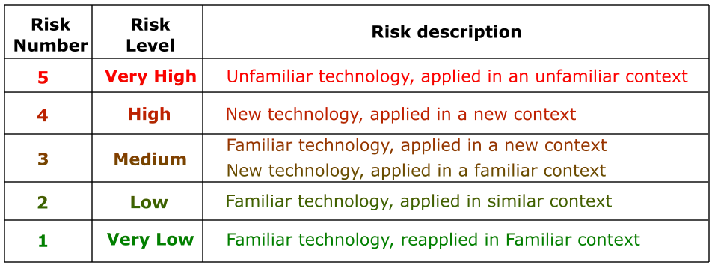
Risks
Generally, aim to minimise risk
Types of risk include, financial, time, and technical risk
Classification of technical risk:
Notes:
The classification of technical risk can be interpreted as follows:
You plan to do something that you’ve done before, using known tools, in EXACTLY the same way. (Basically a copy and paste solution) (12x2 character LCD to a PIC24F MCU)
You plan on doing something that you’ve done before, using known tools, in a similar way (Very little is unknown) (16x4 LCD screen to a PIC24H)
Familiar technology in a new context (LCD screen to a STM32 Nucleo), or New tech to existing context (Graphic LCD to a PIC24F)
New technology to a new context (Graphic LCD to a STM32 Nucleo)
Capacitive Touch screen to a FPGA
From the above it should be clear how the risk (from a level of uncertainty increases. Generally, we would like to remain in the 1-3 range, with some level 4 risks being acceptable. Level 5 risks are inherently very risky and should be minimised if not avoidable. A project with mainly level 5 risks will be very difficult to deliver on time (if at all).
An Electrical Engineering example might be
Using a BJT to drive a DC motor
Using a MOSFET and a 555 to provide PWM to a DC motor
Using a MOSFET H-Bridge to drive a DC motor
Using a H-Bridge driver and DC motor in a overhead crane design
Using a stepper motor and dSPIN driver in a 3D printer design
Note: The above classification of risk is with reference to the analyst. Thus if someone, did something similar on the internet but you’ve not yet the risk remains high. Surely, the risk in real terms might be a little lower (not completely unfamiliar) but you’re depending on the quality of the found solution.

Slide 9
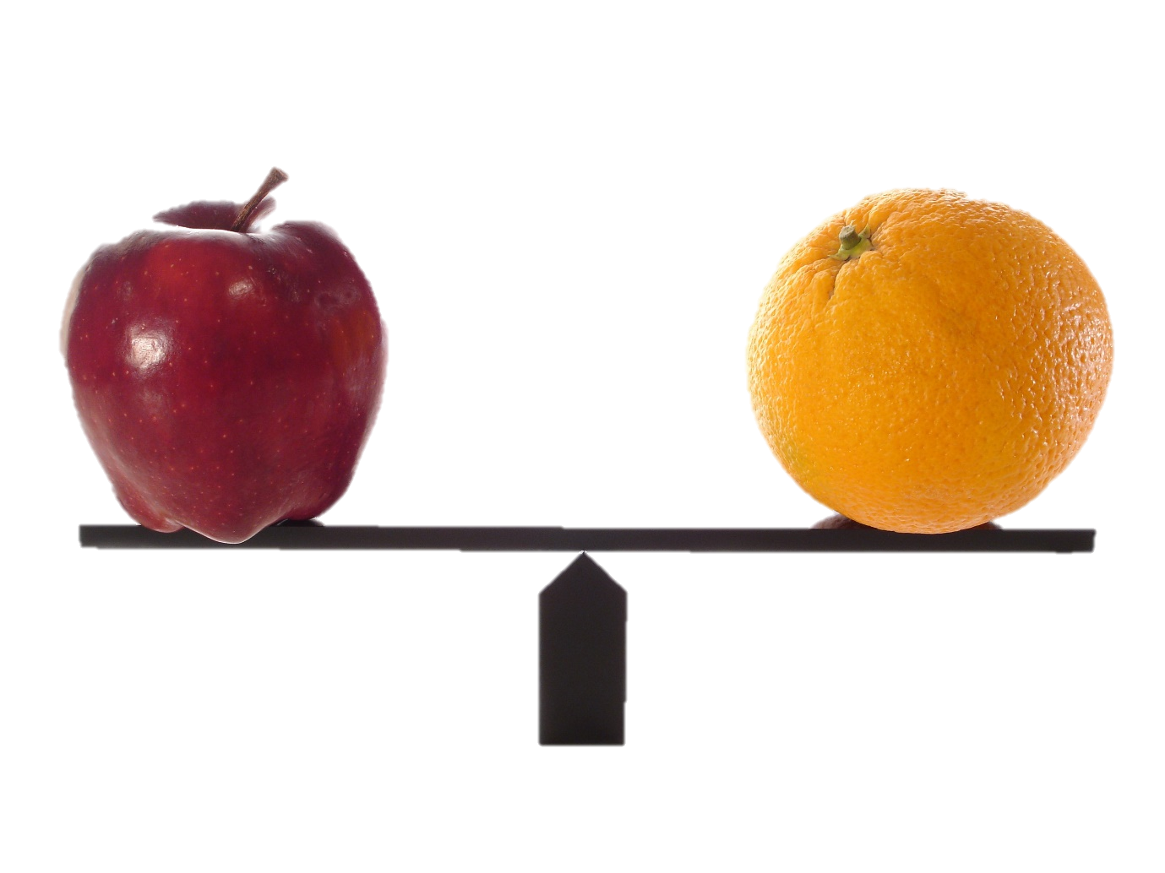
Apples vs Oranges
Comparing different aspects
  Qualitative vs Quantitative
  Cost vs Risk
  Technical vs Non-Technical
Utility functions
  Convert input space to a value between 0 and 1
  Linear, non-linear, and discrete
  Range and type decided beforehand

Slide 10
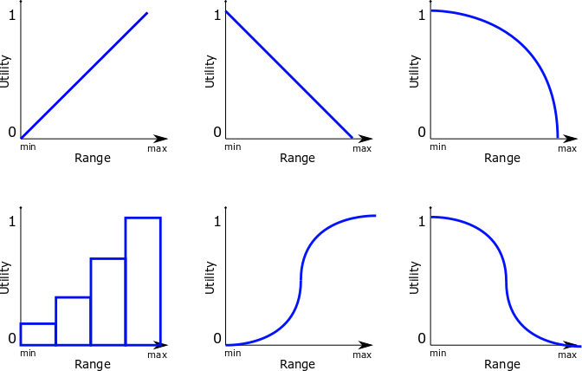
Commonly used Utility Functions
MORE IS BETTER
SLIGHTLY MORE IS ACCEPTABLE
LESS IS BETTER
“Desired cost”
TYPICAL OF MONEY
DISCRETE
(Risk as example)
SIGMOID Functions

Slide 11
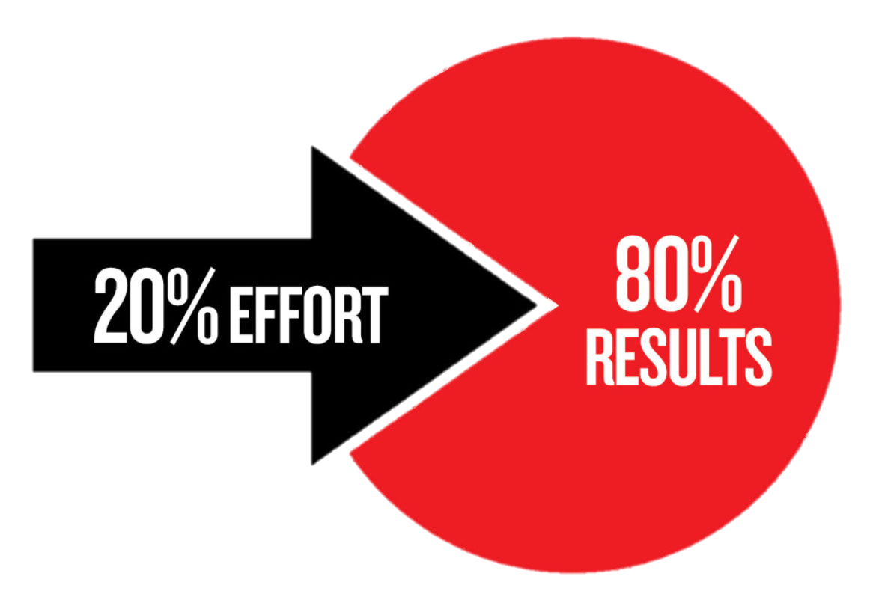
Criteria Selection
You must have technical criteria, risk, and cost
Technical criteria
  Maximum differentiation
  Parameters that are key to performance in system
  Avoid needless duplication (component size and pin count)
  DON’T copy all parameters from a datasheet

Slide 12
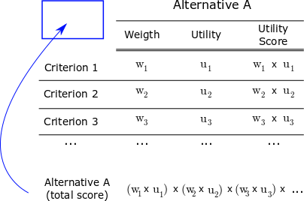
Multi-criteria Decision Matrix (MCDM)
Complete MCDM per Alternative
Weights must sum to 1.0
Alternative with the highest score is selected
Unless there is a good reason,
keep the weights equal

Slide 13
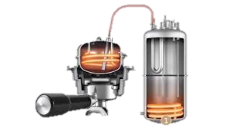
Example time
Measure the current consumption of boiler
  220V_{rms}
  2.5 kW peak consumption
  +/- 11.3 A_{rms}
Measure the water outlet temperature of the machine boiler
  100 ⁰C maximum temperature
  +/- 1 ⁰C resolution
  1 Hz update rate
Do this as an
individual exercise

Slide 14
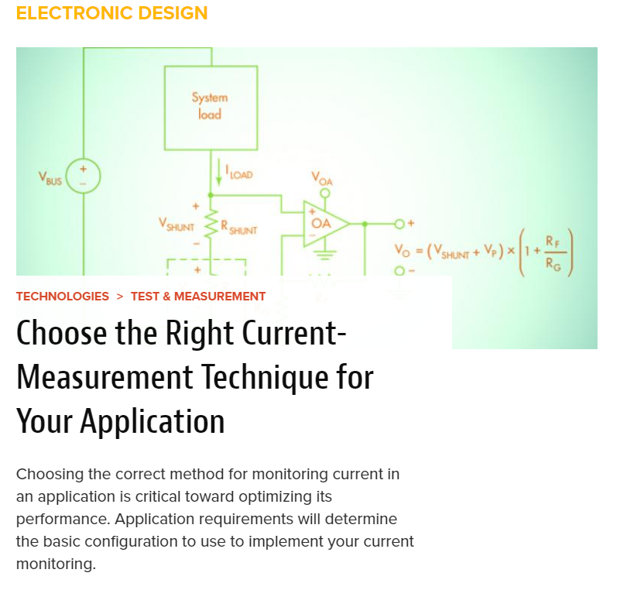
Current measurement
Requirements are known
How to accomplish this?
First decision.
Which technology to use
Internet, Books,
Application Notes,
White papers

Slide 15

Current measurement
Current transformer
  Large current range,
  Physically large
  No DC measurement
  Common
Resistive element
  Very cheap
  No isolation between mains and signal
  Requires additional amplifier
Hall effect sensor
  Isolated
  Commonly used
  Cost effective
  AC and DC measurement
Rogowski coil
  Easy to install
  Good for nanosecond signals
  Requires additional components
Notes:
The resistive element is eliminated based on the system architecture. Since the sensor is connected to the control panel, and the user interacts with the said control panel, isolation between primary and secondary sides of the current transducer is a requirements.
As such the resistive element is not considered as functionally capable. This will not always be the case, and in other scenarios many more alternatives may be removed in this fashion. HOWEVER, justification must always be provided. Simply stating “based on experience” or “in the opinion of” lacks rigour and is not acceptable.

Slide 16
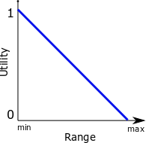
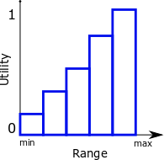
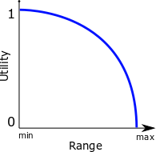
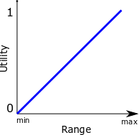
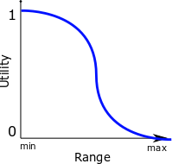
Step 1 – Decide on Utility functions
Risk
  Map 1-5 risks to 0 – 1 range
Component Cost
  Free is best, R300 seems reasonable
  R500 maximum available
Technical parameters to consider
  Lead time
    Immediate best, shorter better
    12 weeks absolute worst
  Measurement range
    Minimum required, more not much better
  Response (bandwidth)
    50Hz at least more better
  Measurement sensitivity
    Finer resolution is better
    mA better than A, up to a point
    Min 0.5A max 1mA
Notes:
The mapping between the input range and the utility value need not be exact. What is required though is that there is a clear justification of values. It should be clear to differentiate between a 0.5, 0.1 and 0.99 utility score simply based on graphical inspection of the value function and the input range.
Obviously, much more mathematically sound mappings can be done. But, keep the pareto principle in mind…

Slide 17
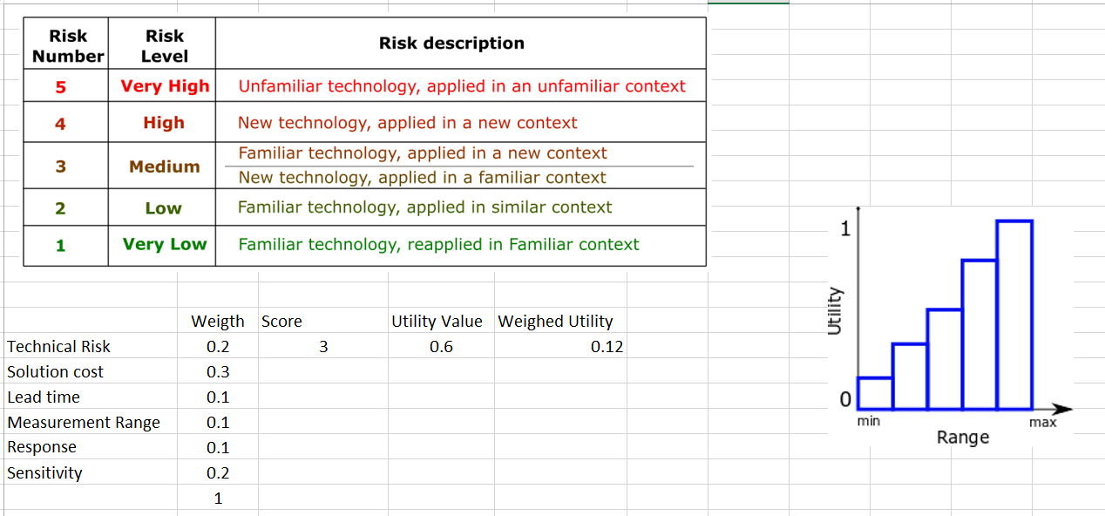
Step 2 – Build MCDM for each Alt.
Current Transformer ex.

Slide 18
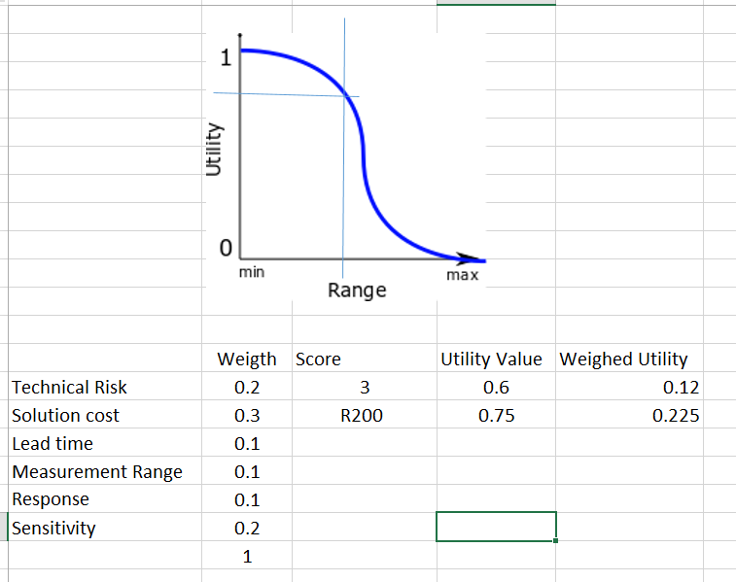
Step 2 – Build MCDM for each Alt.
Current Transformer ex.

Slide 19
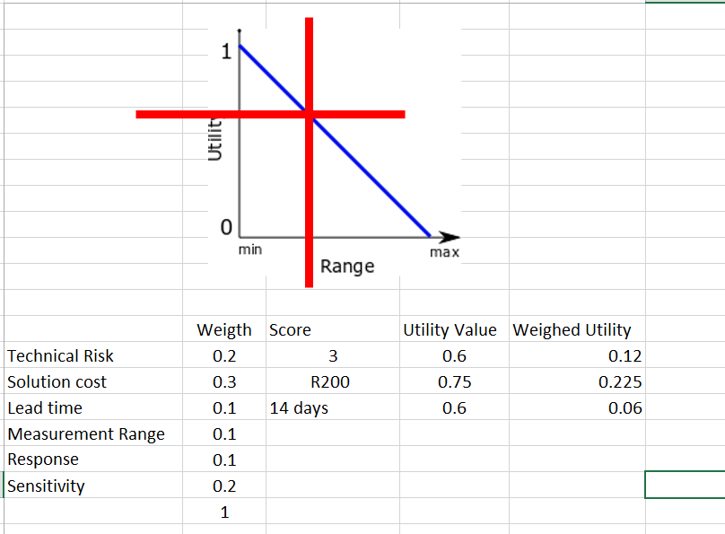
Step 2 – Build MCDM for each Alt.
Current Transformer ex.
12 weeks
immediate

Slide 20
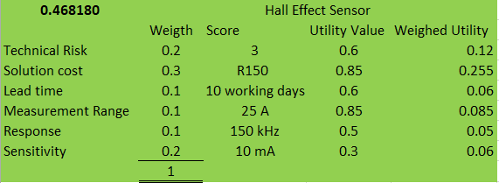
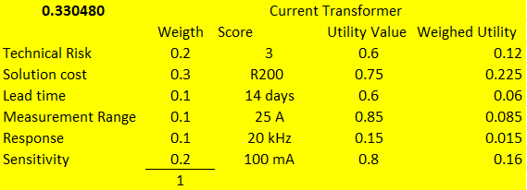
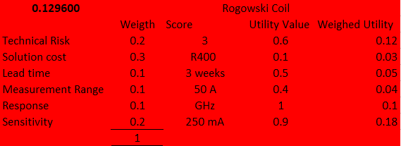
Step 3 – Compare Scores
Best technology type based on criteria and utility functions
Scaled by 10^6
to aid legibility

Slide 21


Selecting the sensor
Technology type is HALL Effect
Search part catalogues
  RS Components
  MOUSER
  Digikey
  Octopart
  Mantech, Electrocomp, CST Electronics, Arrow, Altech

Slide 22
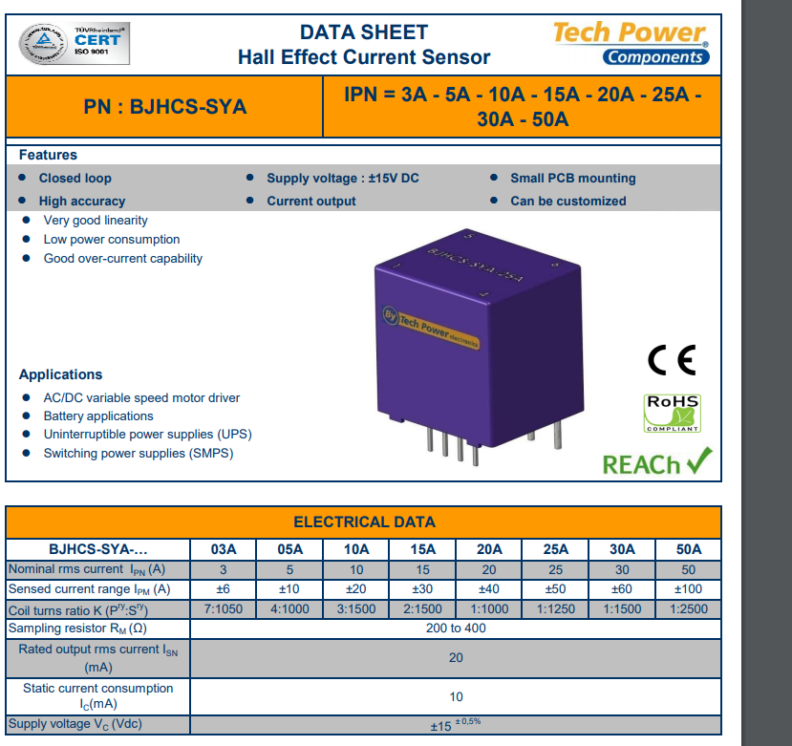
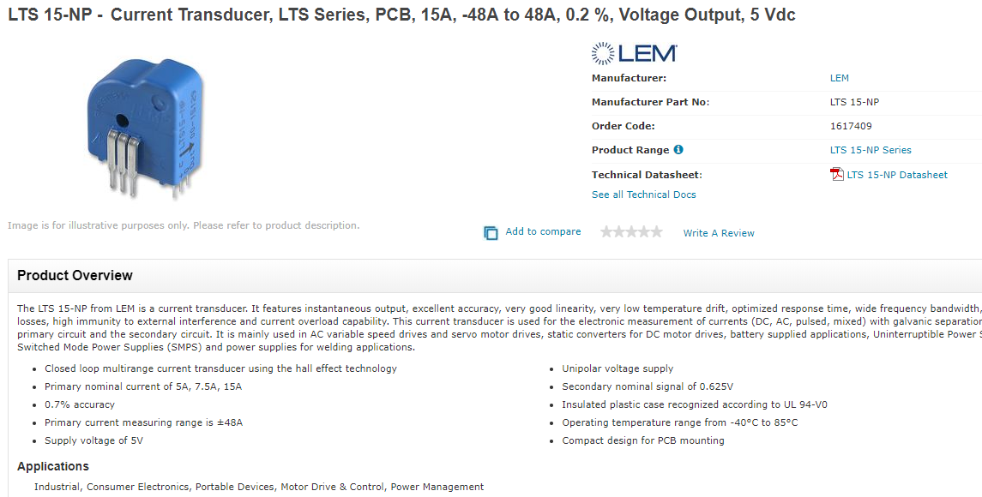
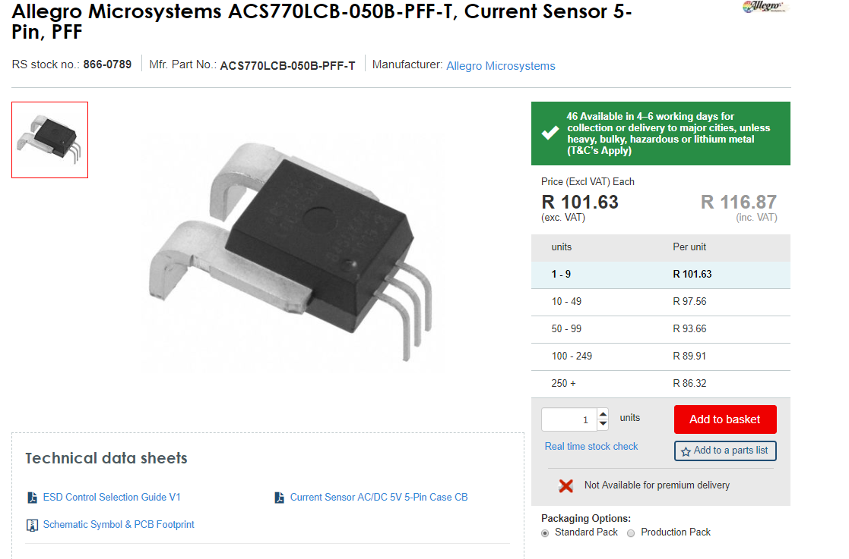
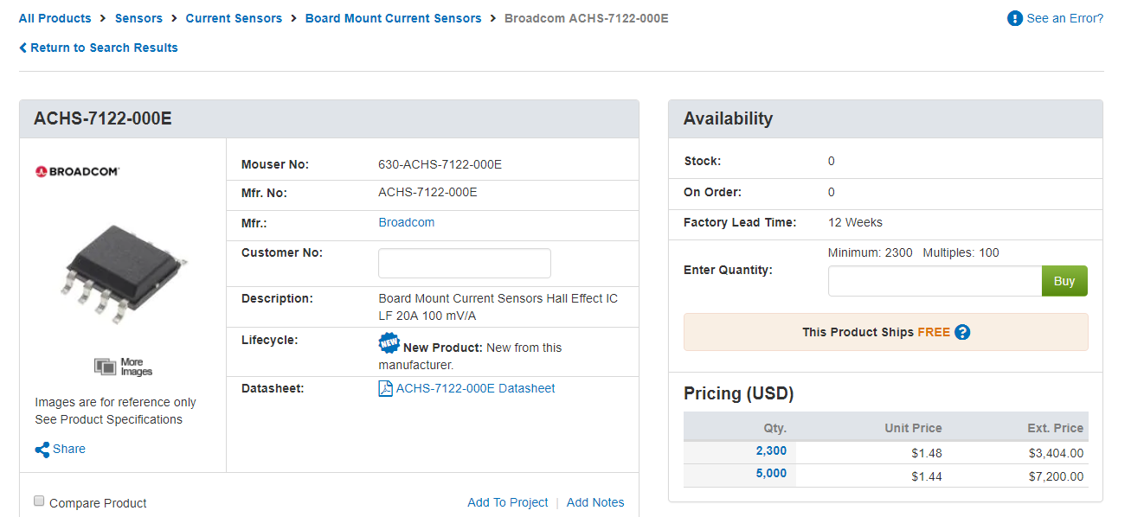
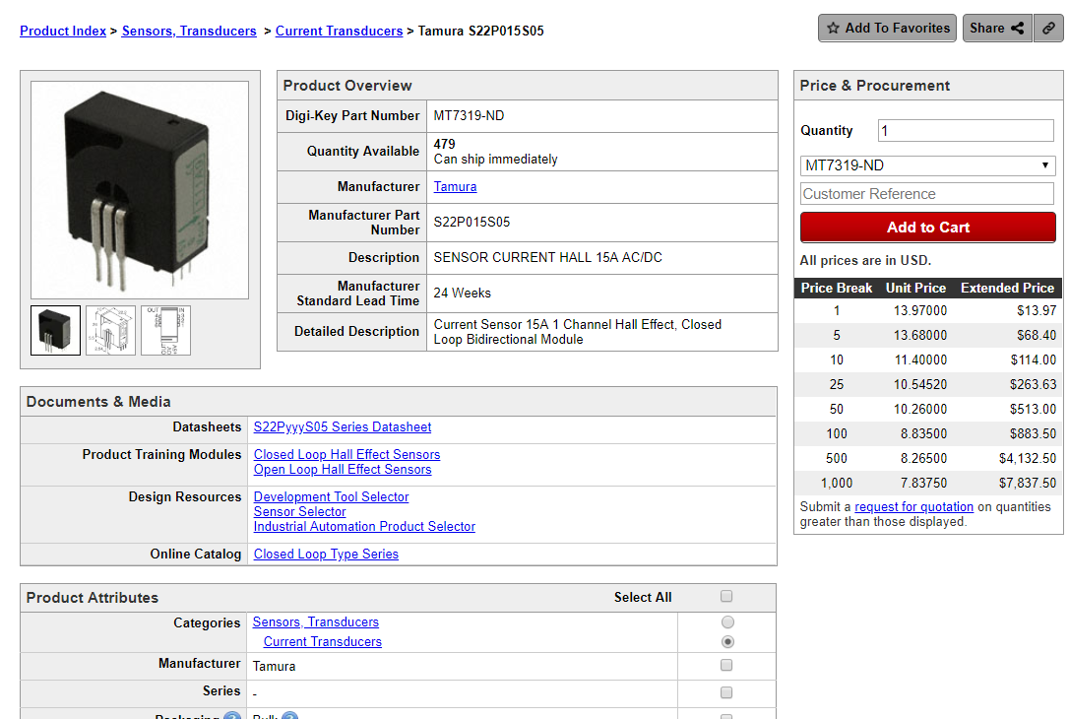
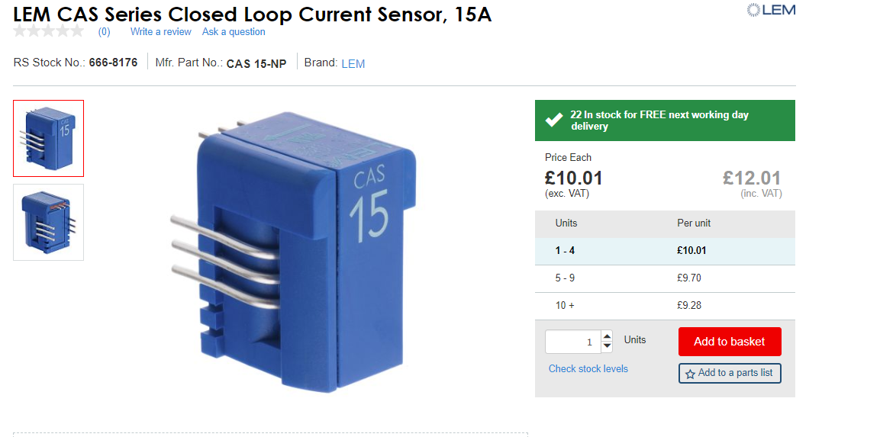
Selecting the sensor
Which sensor to select?
Cheapest? Most accessible? Technically superior?
Compile a MCDM for each sensor
  Include part and delivery cost
  Lead time / Delivery time
  Peruse datasheets to determine implementation complexity
Possible criteria
  Very similar to broad technology type trade
  Adjustment of ranges based on available parts
  Implementation details (discrete selection)
    Only part in question, other components such as buffers, interface logic, etc.

Slide 23

Alternatives
Algorithm development
Embedded system development
Electronics development
Mechanical development
Software development
Notes:
For each of these alternatives some trade-offs can de done.

Slide 24
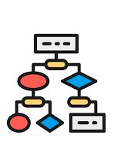
Algorithm Development
System level
  Which algorithms are suitable
  Availability of development tools
  Resource requirements
Component level
  Implementation performance
  Implementation constraints
Metrics to consider
  Stand-alone / cloud-based
  Computational resource requirements
  Development requirements
  Developer experience (don’t over emphasise)

Slide 25
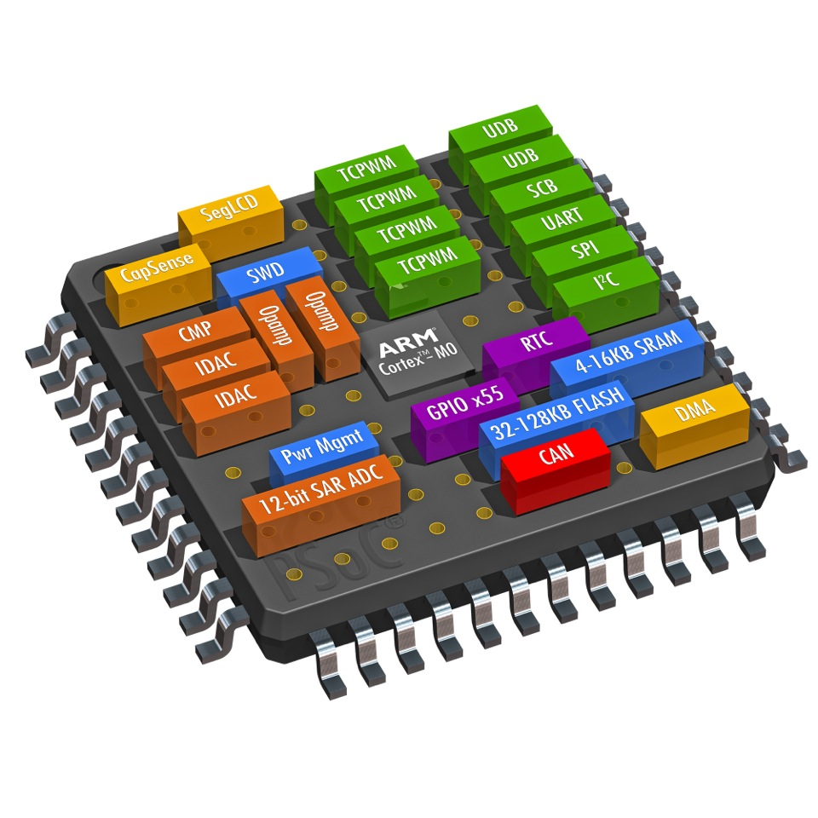
Embedded System Development
System level
  Device classes (8/16/32/+ bit systems)
  Microcontroller vs Single Board computer vs Industrial PC vs PLC
  Operating system / bare metal
  Computational requirements (missile flight controller vs washing machine)
Component level
  Specific parts
  Pin counts, external component requirements
  IO levels
Metrics to consider
  Must be specific enough to make a decision. Comparing a Raspberry Pi to an Arduino doesn’t make sense.
  Raspberry Pi to a Banana Pi and Orange Pi, and Beagle does.

Slide 26
Software System Development
System level
Stand-alone, cloud, hybrid
Native / framework based
Scalability aspects particularly as it pertains to data
Usability requirements
Component level
Specific frameworks / toolboxes / cloud providers
Possibly cloud architecture (if applicable)
Database design
Metrics to consider
Execution performance (test in-house / make use of external reports)
Maintainability requirements
Life-cycle cost

Slide 27
Remember
Any choice is based on a set of criteria (documented or not)
Engineering design requires
  Selection of criteria (possibly defence of…)
  Identification of scores (a fair ruler, and justification of…)
  Documentation of the process
Performing the MCDM process on an invalid design choice (such as STM32 vs Arduino MCUs, or DC motor vs Induction motor) is of no use and will not be graded

Slide 28

In conclusion
Limit subjectivity as much as possible
Avoid similar factors
  Pin count vs part size vs part weight
Simply placing the focus on the analyst’s experience is bad!
Cost is not everything
Considering only cost is INCOMPLETE

